Slide 1
8086 Pin Configuration

Slide 2
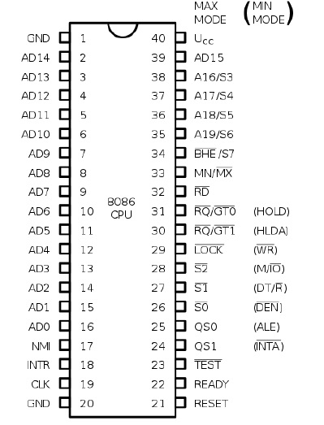
Pin Structure
It has 40-pin DIP (Dual Inline Package) chip.
The 8086 operates in single processor or multiprocessor configuration to achieve high performance.
The pins serve a particular function in minimum mode (single processor mode ) and other function in maximum mode configuration (multiprocessor mode ).
The 8086 signals can be categorized in three groups:
The signal having common functions in minimum as well as maximum mode.
the signals which have special functions for minimum mode(one processor)
the signals having special functions for maximum mode(multiprocessor).

Slide 3
Common Pins in 8086
AD15-AD0:
Pins:2-16,39
These are bidirectional(used as input and out put),multiplexed memory/input output addresses and data bus pins.
AD0-AD7 carries low order byte data and AD8-AD15 carries higher order byte data.
During the first clock cycle, it carries 16-bit address and after that it carries 16-bit data.
A19/S6-A16/S3
Pins:35-38
A19/S6,A18/S5,A17/S4,A16/S3: These are the time multiplexed address and status lines.
During first clock cycle(T1 state) these contain address information.
  High specifies memory operation.
  Low specifies I/O operation.
In later part contain status bits.
S5 is used to show the status of interrupt flag. At the beginning of each clock cycle.
A16/S3 and A17/S4 are encoded according to the table on the right side.
Function Status of bits S6-S3

Slide 4
Vcc:
It uses 5V DC supply at V_{CC} pin 40
GND
These are ground at V_{SS} pin 1 and 20.
Clock
Clock signal is provided through Pin-19.
It provides timing to the processor for operations. Its frequency is different for different versions, i.e. 5MHz, 8MHz and 10MHz.

Slide 5
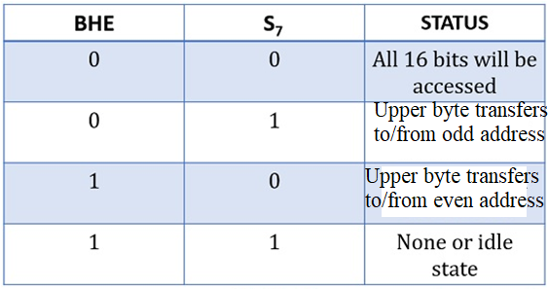
S7/BHE’:
BHE stands for Bus High Enable.
Pin no:34
The combination of the BHE signal and S₇ status informs about the existence of the data on the bus.
It is used to indicate the transfer of data using data bus D8-D15.
different combinations show whether the bus is containing overall 16 bit, upper byte or lower byte of the data

Slide 6
INTR
INTR stands for an interrupt request.
Pin:18
It is sampled during the last clock cycle of each instruction by the processor.
if the signal at this pin is found to be high then the processor controls that interrupt internally.
Read(RD)’
It is available at pin 32
It is low when it is receiving the data from memory/IO,
𝐑𝐞𝐚𝐝𝐲
It is available at pin 32.
It is an active high signal. When it is high, it indicates that the device is ready to transfer data. When it is low, it indicates wait state.
RESET
It is available at pin 21 and is used to restart the execution.
It causes the processor to immediately terminate its present activity.

Slide 7
NMI
It stands for non-maskable interrupt and is available at pin 17.
It is an edge triggered input, which causes an interrupt request to the microprocessor.
TEST’
This signal is like wait state and is available at pin 23.
When this signal is high, then the processor has to wait for IDLE state, when goes low, the execution continues.
MN/MX’
It stands for Minimum/Maximum and is available at pin 33.
It indicates what mode the processor is to operate in; when it is high, it works in the minimum mode and vice-versa.

Slide 8
Pins in Minimum mode
INTA’ (Pin number 24)
It is an interrupt acknowledge pin.
Whenever an INTR signal is generated, then the microprocessor generates INTA signal, as a response to that interrupt.
INTA is low in two consecutive bus cycles.
The first pulse indicates interrupt acknowledgement and during second pulse, type of interrupt is shown on the data bus.
ALE – Pin number 25
ALE is an abbreviation for address latch enable.
when pulse goes high means ALE=1, it makes address bus enable and when ALE=0, means low pulse makes data bus enable.
DEN’ – Pin number 26 –
DEN is used for data enable.
This is an active low pin that means whenever a 0 is present at this pin then the transceiver gets enabled and it separates the data from the multiplexed address and data bus.

Slide 9
DT/R’(Data Transmit/Receive) – Pin number 27
This pin is used to show whether the data is getting transmitted or is received.
A high signal at this pin provides the information regarding the transmission of data. While a low indicates reception of data.
M/IO’ – Pin number 28 –
This pin indicates whether the processor is performing an operation with memory or I/O devices.
Whenever a high is present at this pin then it shows the operation is carried out through the memory.
While a low signal shows operation through I/O devices.
WR’ – Pin number 29 –
An active low signal at this pin indicates that the processor is performing write operation from either memory or I/O devices.
HOLD – Pin number 31 –
When an external device enables this pin then the processor stops accessing the buses immediately after the recent task gets over.
HLDA – Pin number 30 –
This pin is used as a response pin for the hold request. Once request for accessing the buses is produced by an external entity. Then the microprocessor acknowledges the device that its request will be considered once it gets over by the current operation.

Slide 10
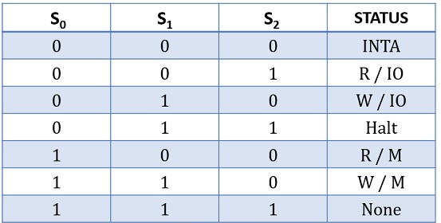
Pins in Maximum mode
s0’,s1’,s2’ – Pin number 26 to 28
These three signals are decoded by the bus controller to provide eight separate control signals.
This means that if the status at all the 3 pins is 0 then it shows that multiple interrupts are to be handled in maximum mode.

Slide 11
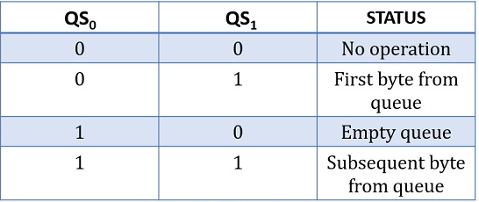
QS₀ and QS₁ (Queue Status) – Pin number 24 and 25
These two pins indicate the status of the 6-byte pre-fetch queue present in the architecture of 8086.

Slide 12
LOCK’ – Pin number 29
When this signal is low, it indicates to the other processors not to ask the CPU to leave the system bus.
RQ’/ GT₀ ’and RQ’/ GT₁‘ – Pin number 30 and 31 –
Due to the involvement of multiple processors, these pins indicate the request and grant permission for accessing the buses, memory and peripherals.
In max mode HOLD and HLDA signals are replaced by RQ’(Bus Request)/GT0’(Bus Grant) RQ’/GT1’ signals.
By using the bus request signal another master can request for the system bus and microprocessor communicates that the request is granted to the requesting master by using bus grant signal.

